Slide 1


Which initiatives to select?
Neda Pourreza
Michael O'Sullivan

Slide 2
Idea
Step 1: First, we measured the similarity and the differences between every pair of the initiatives in terms of word similarity corresponding to “Description” and “Mission” variables. The method we applied is “text mining”. The process assigns the initiatives to some clusters.
Step 2: Second, we added “Category” and “Domain” variables to the clusters determined in the first step to find the final similarity of every pair of the initiatives.

Slide 3
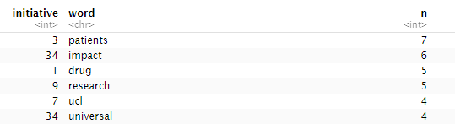
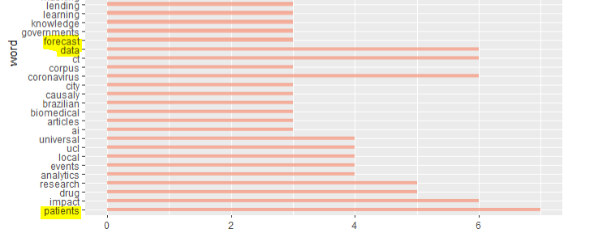
Text mining process
1. Finding the frequency of each word in each initiative, and across all initiatives.

Slide 4
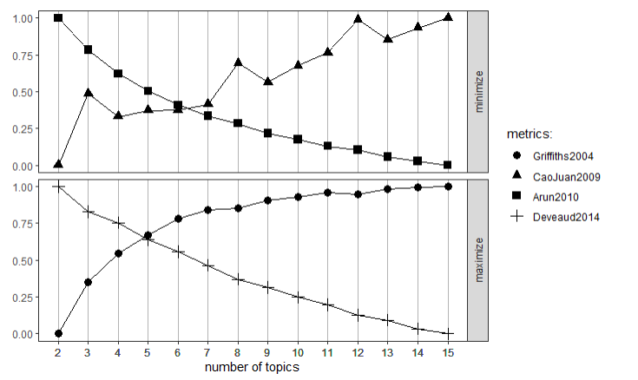
2. Funding the number of clusters (topics) based on word frequencies.

Slide 5
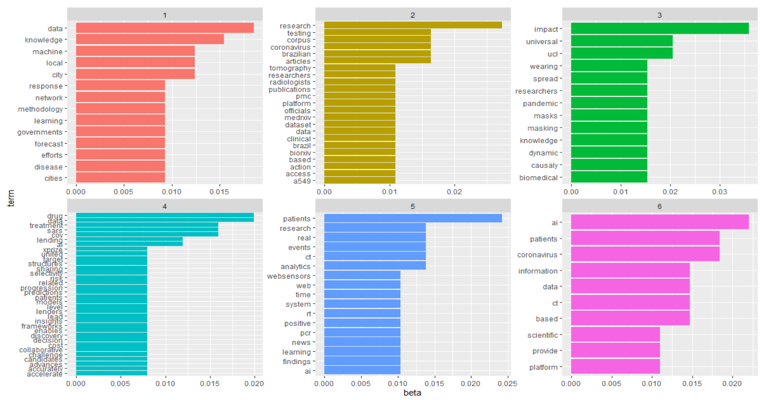

Slide 6
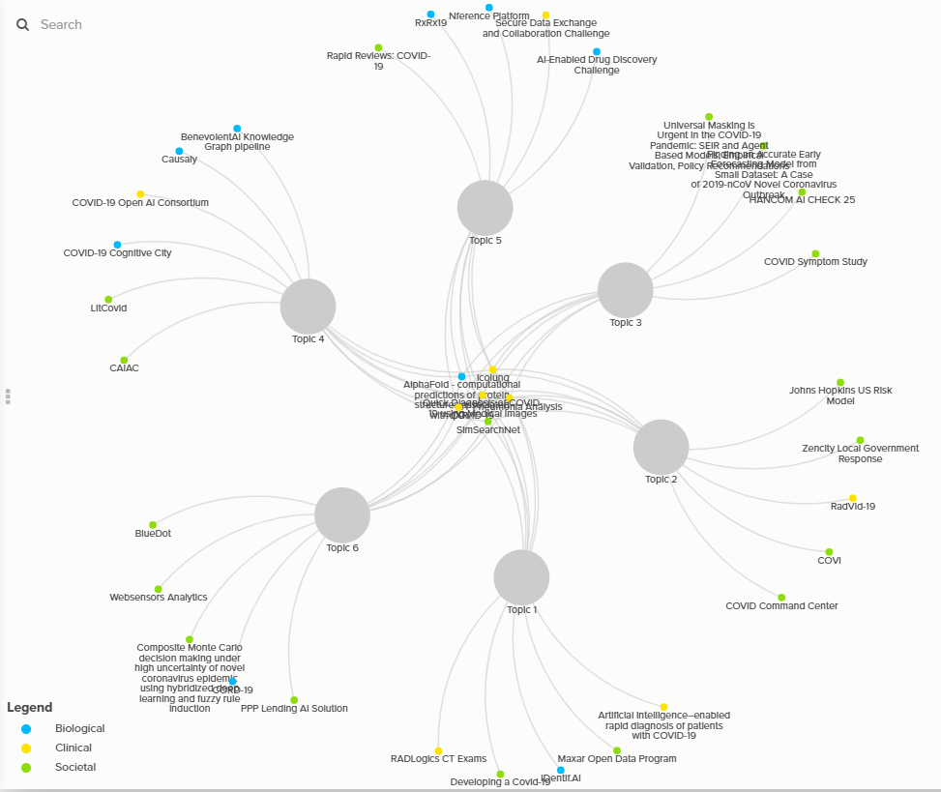

Slide 7
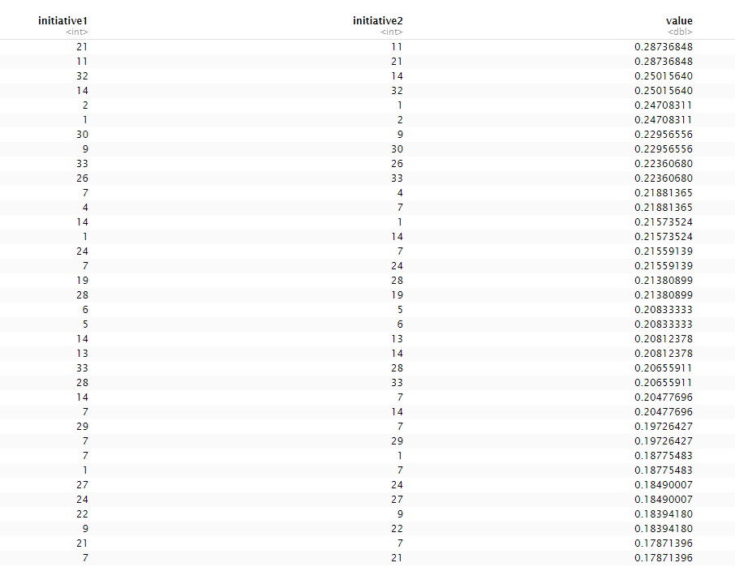
Similarity between initiatives corresponding to text similarity

Slide 8
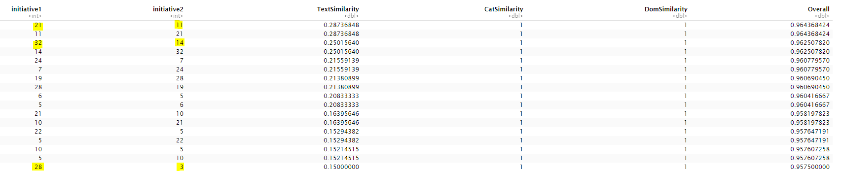
Adding “Category” and “Domain” to find similarity

Slide 9


